Slide 1
Narrow vs Broad phase detection
Narrow phase:
The actual “what’s hit what” (and whatever information we need/want from that).
Sphere-Sphere, ray-triangle, whatever-whatever
2 parts: detection (what we’re doing) and response
What you see (render) isn’t usually what you’re detecting
Simplify with a sphere, point, some simple shape – rarely a mesh
CATCH: This rarely actually happens (over time)
Broad phase:
How to we detect when the narrow is happening?
How to we limit what is being compared to what?

Slide 2
Spatial partitioning using AABB
Broad phase:
Broad phase has to be really fast.
This is anything in the physics loop that is before the narrow phase
We are going to “partition the space” of the scene (that’s why it’s called “Spatial Partitioning”
1. AABBs and detection (“Axis Aligned Bounding Box”)
They are “aligned” with the axis – i.e. they never rotate
Can be a cube or a “rectangle” shape (same or different dimensions)
Compared to an OBB (Oriented Bounding Box), which has a rotation.
2. Determine how to represent these AABBs
3. Determine how to store many of these
4. Find a way to store geometry and…
5. …how to find these AABBs very quickly

Slide 3
Width, Height, Depth
Y
0,0 (origin)
X

Slide 4
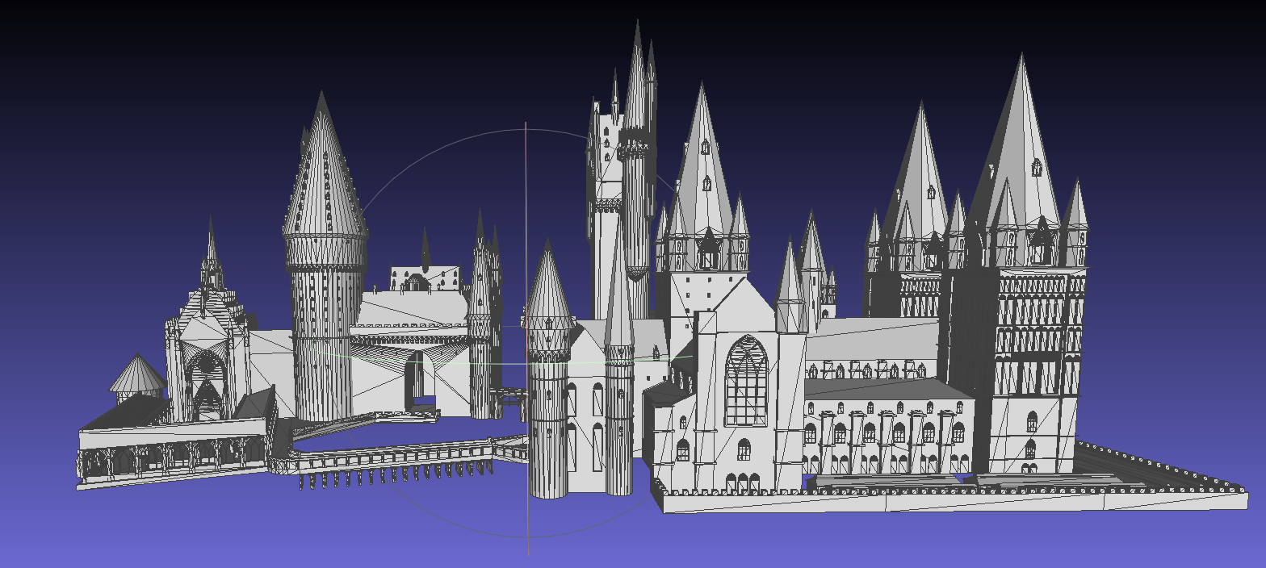
Width (X) = 20
Height (Y) = 10
Width (X) = 20
Height (Y) = 10
X,Y
Y
0,0 (Location)
0,0 (Location)
X
If ( Ball_X < AABB.Width) && ( Ball_X >= AABB.0 ) &&
( Ball_Y …

Slide 5
If (ball_X < Box_min_X ) → It’s NOT inside
If (ball_X >= Box_max_X) → BYE!
If (ball_Y < Ball_min_Y) → BYE!
Width (X) = 20
Height (Y) = 10
X,Y
0,0 (Location)
Y
X

Slide 6
If (ball_X < Box_min_X ) → It’s NOT inside
If (ball_X >= Box_max_X) → BYE!
If (ball_Y < Ball_min_Y) → BYE!
Width (X) = 20
Height (Y) = 10
Width (X) = 20
Height (Y) = 10
0,0 (Location)
Y
0,0 (Location)
X

Slide 7
Width (X) = 20
Height (Y) = 10
Width (X) = 20
Height (Y) = 10
0,0 (Location)
0,0 (Location)
Width (X) = 20
Height (Y) = 10
Width (X) = 20
Height (Y) = 10
0,0 (Location)
0,0 (Location)

Slide 8
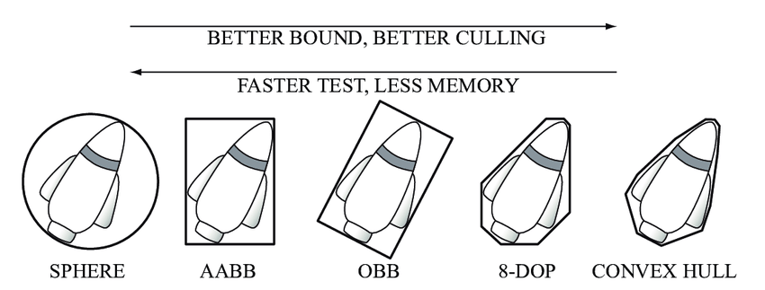
1. AABB vs OBB
AABBs: quicker to test (take up less memory – but we don’t really care about that)
For scene spatial partitioning, OOBs are almost certainly “overkill”
May not match the shape as well.
If object rotates, may have to be recalculated.
From: https://www.researchgate.net/figure/Bounding-volumes-sphere-axis-aligned-bounding-box-AABB-oriented-bounding-box_fig9_272093426QAAAAAdAAAAABAE

Slide 9
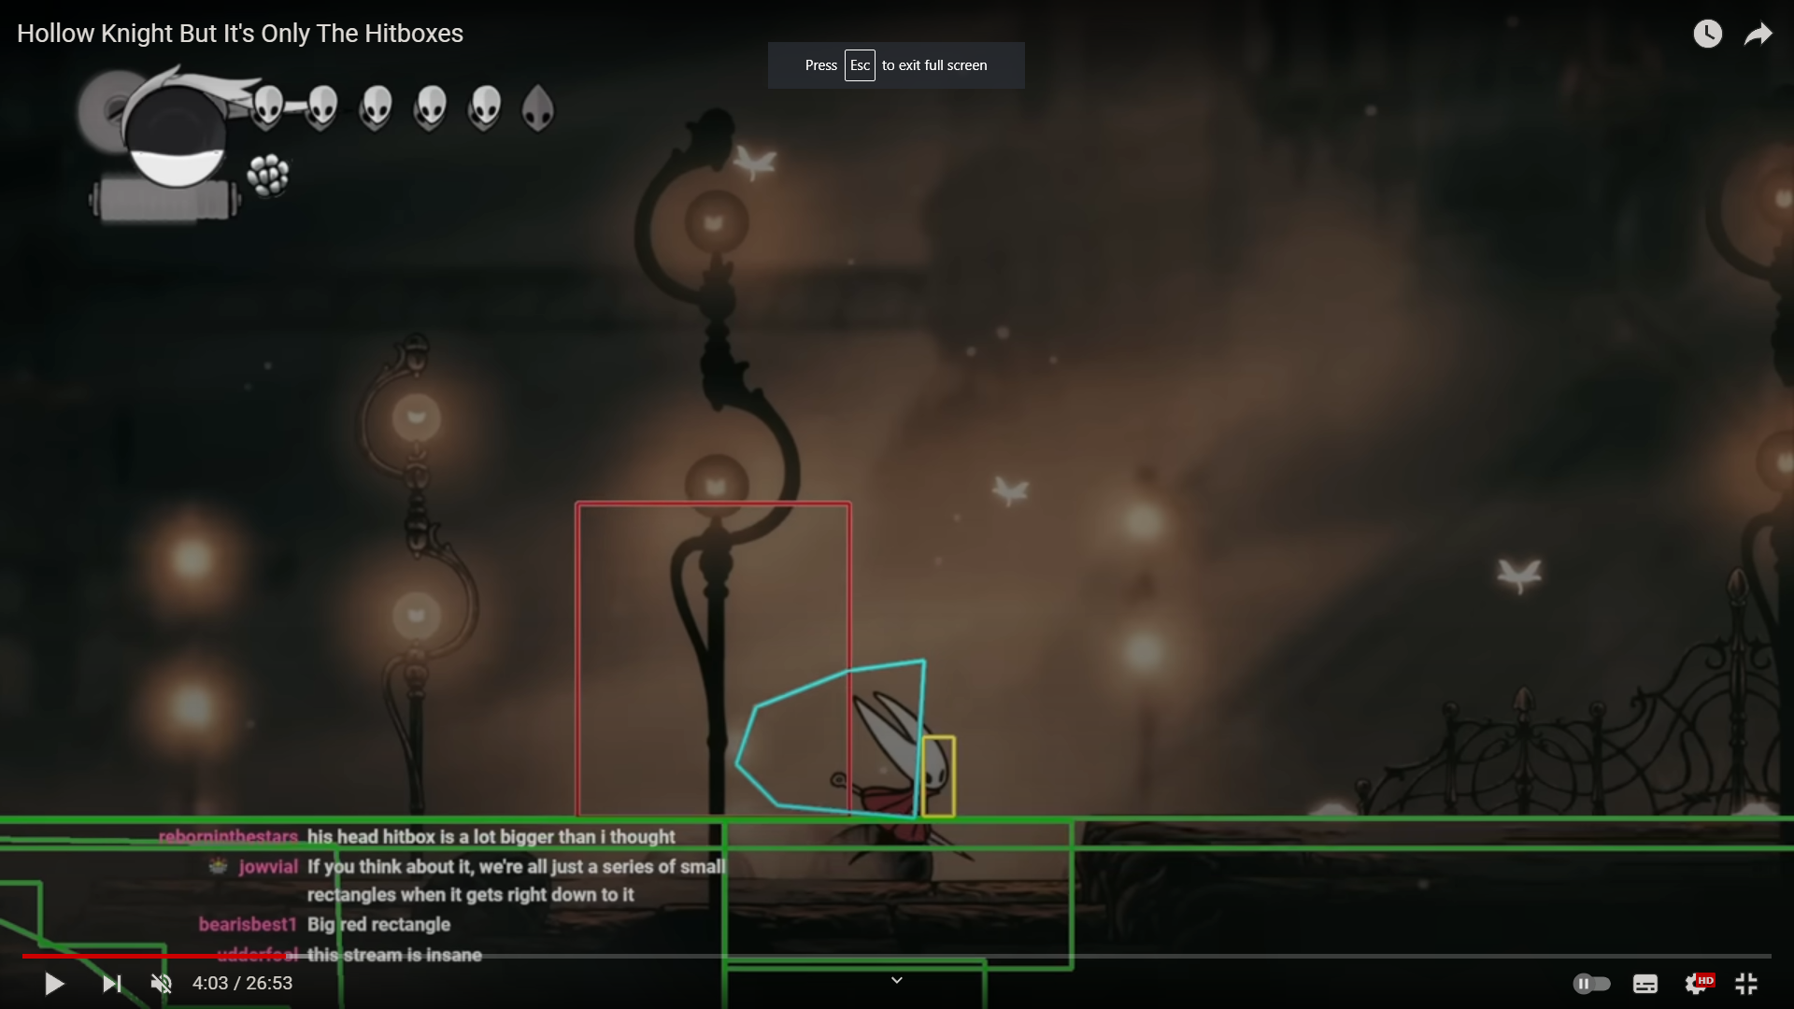
1. AABB vs OBB: Hollow Knight But It’s Only Hitboxes
From: https://youtu.be/DDKoy6XTfTA?t=243

Slide 10
2. How to represent these AABBs
But the LEAST number of attributes to describe your AABB, then:
STICK WITH THAT (don’t change it mid-project)
Use methods to get any other info you need
glm::vec3 centreXYZ;
float length, width, height;
// Or more specifically:
float length_X, width_Y, height_Z;
glm::vec3 centreXYX;
float size;// If it's a cube
glm::vec3 minXYZ;
glm::vec3 maxXYZ;
// Havok, Bullet, etc.:
glm::vec3 centreXYZ;
glm::vec3 halfLengthsXYZ;
glm::vec3 minXYZ;
glm::vec3 extentsXYZ;

Slide 11
2. How to represent these AABBs
But the LEAST number of attributes to describe your AABB, then:
STICK WITH THAT (don’t change it mid-project)
Use methods to get any other info you need
(You could make the getters “inline” if it makes you feel better 🤷‍♂️)
// DON'T Make them ALL variables glm::vec3 centreXYZ;
glm::vec3 halfLengthsXYZ;
glm::vec3 minXYZ;
glm::vec3 maxXYZ;
glm::vec3 extents;
void Update(void);
// Choose “key” variables,
// Make rest “get” methods
glm::vec3 centreXYZ;
glm::vec3 halfLengthsXYZ; glm::vec3 getMinXYZ(void);
glm::vec3 getMaxXYZ(void);
glm::vec3 getExtentsXYZ(void);

Slide 12
3. Determine how to store them
Remember we are storing scene information, “slicing” up the scene into many AABBs. This is how we store all the AABBs that make up the scene (where each AABB has some of the scene geometry)
glm::vec3 minXYZ;
glm::vec3 maxXYZ;
3 floats * 4 bytes/float * 2 = 24
static const unsigned int NUM_BOXES = 10;// Per axis
// 10,000 * 24 = 240,000
cAABB theAABBs[NUM_BOXES][NUM_BOXES][NUM_BOXES];
Array is stack based at compile time.
How big, though?
Each AABB is 24 bytes
Total: 240 K
static const unsigned int NUM_BOXES = 100;// Per axis
// 1,000,000 * 24 = 24,000,000 (24 Mbytes)
cAABB theAABBs[NUM_BOXES][NUM_BOXES][NUM_BOXES];
Remember the stack is only 1 Mbyte total (for all stack variables)
static const unsigned int NUM_BOXES = 100;// Per axis
cAABB* theAABBs[NUM_BOXES][NUM_BOXES][NUM_BOXES];
// 1,000,000 * 4 (or 8) = 4 or 8 Mbytes
Even with pointers, it might be too big for the stack…

Slide 13
3. Binary partitioning
glm::vec3 minXYZ;
glm::vec3 maxXYZ;
3 floats * 4 bytes/float * 2 = 24
We could also divide the scene/world/asset into binary partitions (2x2x2 AABBs)
This might be enough…
…or we could then store another set of 2x2x2 inside each AABB
Like a “child” set of AABBs
Called an “oct-tree” as there are 8 AABBs per level.
static const unsigned int NUM_BOXES = 2;// Per axis
cAABB theAABBs[NUM_BOXES][NUM_BOXES][NUM_BOXES];

Slide 14
3. Determine how to store them
Remember we are storing scene information, “slicing” up the scene into many AABBs. This is how we store all the AABBs that make up the scene (where each AABB has some of the scene geometry)
A reasonable approach (vector data is on heap) but keep in mind that while you can access the vector like a 3D array, it isn’t initialized at the start (like a stack based array).
Not a “big deal”, but something to consider…
std::vector< std::vector< std::vector<cAABB> > > vecAABBs;
//vecAABBs[3][2][4] → ERROR!

Slide 15
3. Determine how to store them
Recall that all memory on the computer is really 1D (RAM is just a massive 1D array, right?), so you could store it as a lookup/hash situation, maybe using a map (dictionary) object:
Maps act like arrays, i.e. you access them like: mapAABB[index], but they aren’t stored like that: not every index has something in it.
Sort of like this: mapAABB[“23, 9, 45”] → gets the box you want
(but we’re not going to store it as a string)
std::map<unsigned int /*indexXYZ*/, cAABB> mapAABBs;

Slide 16
5. Hashing or indexing
unsigned int getLocationIndex(void)
{
unsigned int theX = (unsigned int)this->minXYZ.x;
unsigned int theY = (unsigned int)this->minXYZ.y;
unsigned int theZ = (unsigned int)this->minXYZ.z;
unsigned int theIndex = (theX * 1000 * 1000) + // 32 bits 8 bits per digit
(theY * 1000) + // Unsigned char: 0 to 255
(theZ); // 32 bits ---> 4 billion
// 4,000,000,000
// xxx,yyy,zzz
// or you can use 64 bits, where each axis can have 6 digits
unsigned long long theIndex = (theX * 1000'000 * 1000'000) +
(theY * 1000'000) +
(theZ);
// 4 billion * 4 billion 16,000,000,000,000,000,000 // xxx,xxx yyy,yyy zzz,zzz

Slide 17
5. Hashing or indexing
unsigned int getLocationIndex(void)
{
unsigned int theX = (unsigned int)this->minXYZ.x;
unsigned int theY = (unsigned int)this->minXYZ.y;
unsigned int theZ = (unsigned int)this->minXYZ.z;
unsigned int theIndex = (theX * 1000 * 1000) +
(theY * 1000) +
(theZ);
If you ignore the box size, say they are 10x10x10:
On the x: 0 – 10: → 0
The next one is 10-20 → 10
So a box at 0,0,0 → 0 (or 000,000,000)
A box at 60, 30, 70 → ( 060,030,070 or 60,030,070)

Slide 18
5. Hashing or indexing
unsigned int getLocationIndex(void)
{
unsigned int theX = (unsigned int) (this->minXYZ.x / AABB.Xlength);
unsigned int theY = (unsigned int) (this->minXYZ.y / AABB.Ylength;
unsigned int theZ = (unsigned int) (this->minXYZ.z / AABB.Zlength);
unsigned int theIndex = (theX * 1000 * 1000) +
(theY * 1000) +
(theZ);
This way, all the boxes will use up all the digits
So a box at 0,0,0 → 0 (or 000,000,000)
A box at 60, 30, 70 → ( 006,003,007 or 6,003,007)

Slide 19
5. How to find what box your player is in..
// Assuming the AABBs are stored by minimum XYZ:
// eg: 10x10x10 AABB on x: 120.0 to 130.0, y: 60.0 to 70.0, etc.
unsigned int getLocationIndex(glm::vec3 testPointXYZ, glm::vec3 sizeXYZ /*=10*/)
{
unsigned int theX = (unsigned int) roundDown(testPointXYZ.x); // floor()
unsigned int theY = (unsigned int) roundDown(testPointXYZ.y);
unsigned int theZ = (unsigned int) roundDown(testPointXYZ.z);
Recall that roundDown can also be hanlded by just converting it to an int (removing the decimal point)
floor() is a “round down” function and returns a float, rather than an int.

Slide 20
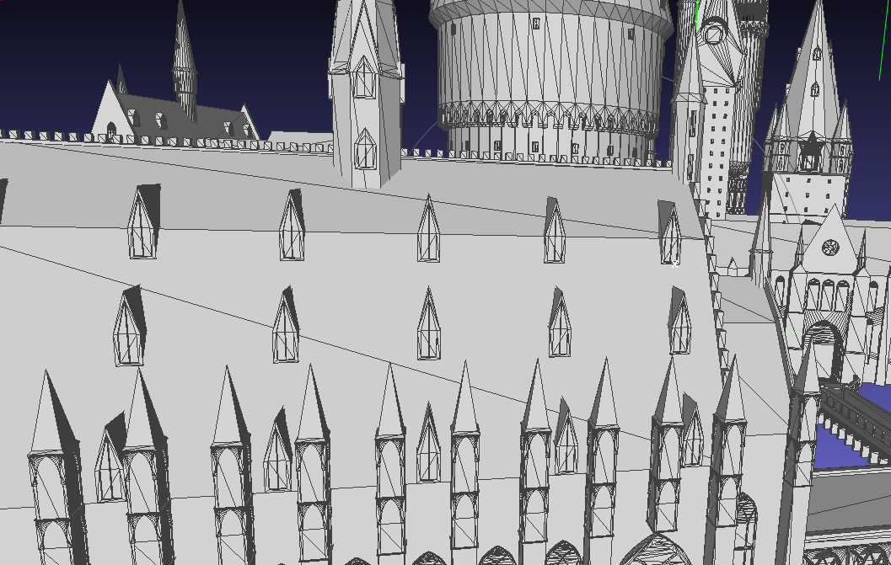
4. Store geometry…
Much more soon, but how about really large triangles?
Too big for the AABB?
Roof triangle TOO big.
Possible:
Divide until triangle is small enough to fit? Perhaps ½ the AABB size?
Then store original verts
You could also do an AABB/triangle intersection test, like this one: https://fileadmin.cs.lth.se/cs/Personal/Tomas_Akenine-Moller/code/tribox_tam.pdf
Or Ericson’s code: === Section 5.2.9: int TestTriangleAABB(Point v0, Point v1, Point v2, AABB b)

Slide 21
PS3 : “Cell” processor + nVidia GPU
2 core PowerPC (old apple) PPU (regular 32 bit CPU)
8 core SPU
So fast that the PPU would send data to 1 SPU at a time, then have just enough time to pick up the result
256 Mbytes of RAM that needed the DMA
Motorola, SONY, and IBM
SONY used it as the ONE chip in their TVs.
Replace the SPU with your GPU, then you “get it”
I mention this because “Little Big Planet” had no Broad Phase in the physics even though it was very much a “physics game”

